Slide 1
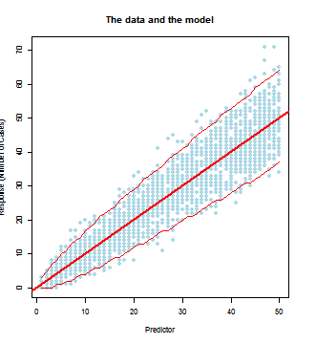
The data and the model: an introduction
Petr Keil
petr.keil@yale.edu
www.petrkeil.com
11/7/2013

Slide 2
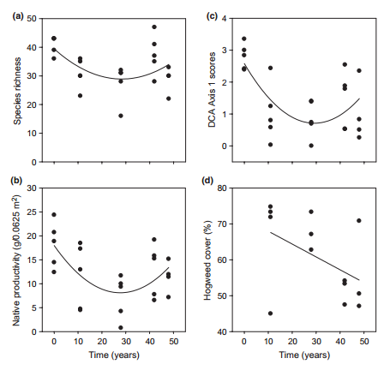
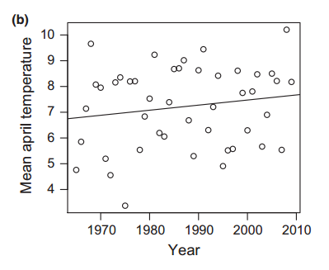
Bartholomeus et al. 2013 Eco. Lett.
Dostal et al. 2013 Eco. Lett.

Slide 3
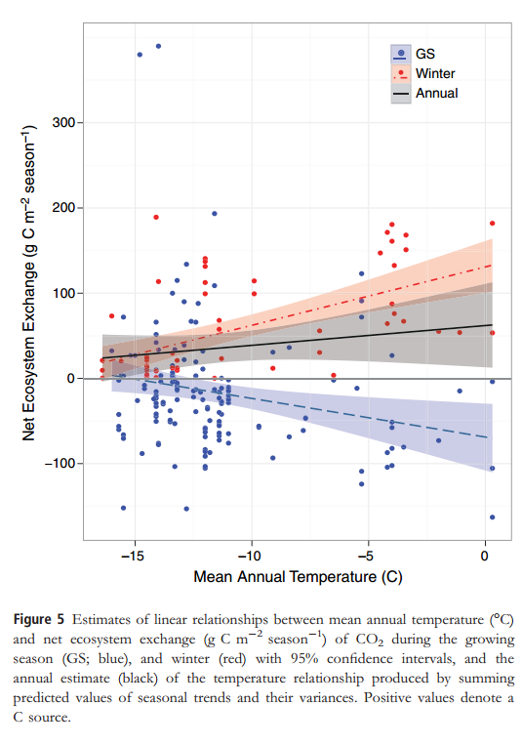
Belshe, Schurr & Bolker et al. 2013 Eco. Lett.

Slide 4
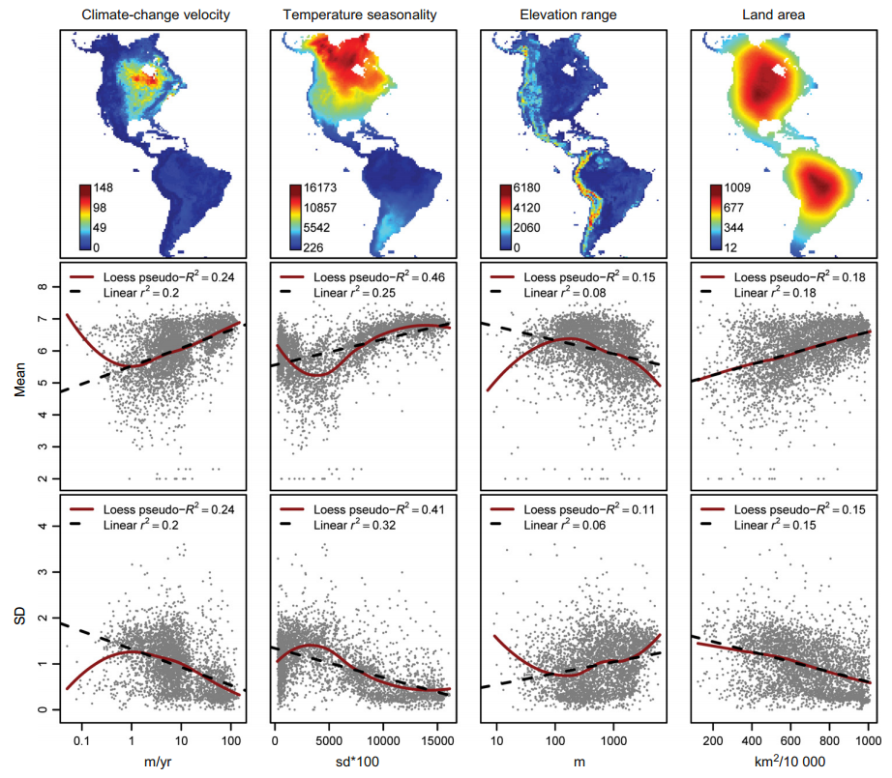
Morueta-Holme et al. 2013 Eco. Lett.

Slide 5
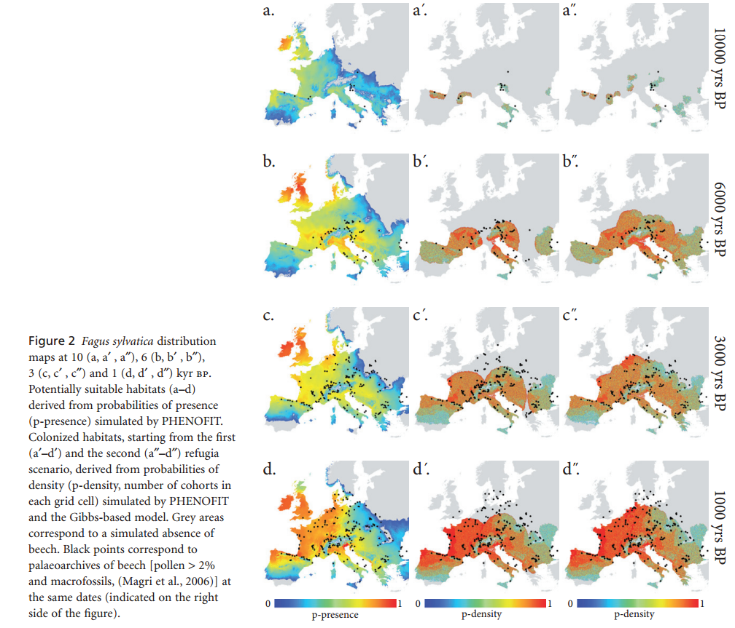
Saltre et al. 2013 GEB

Slide 6
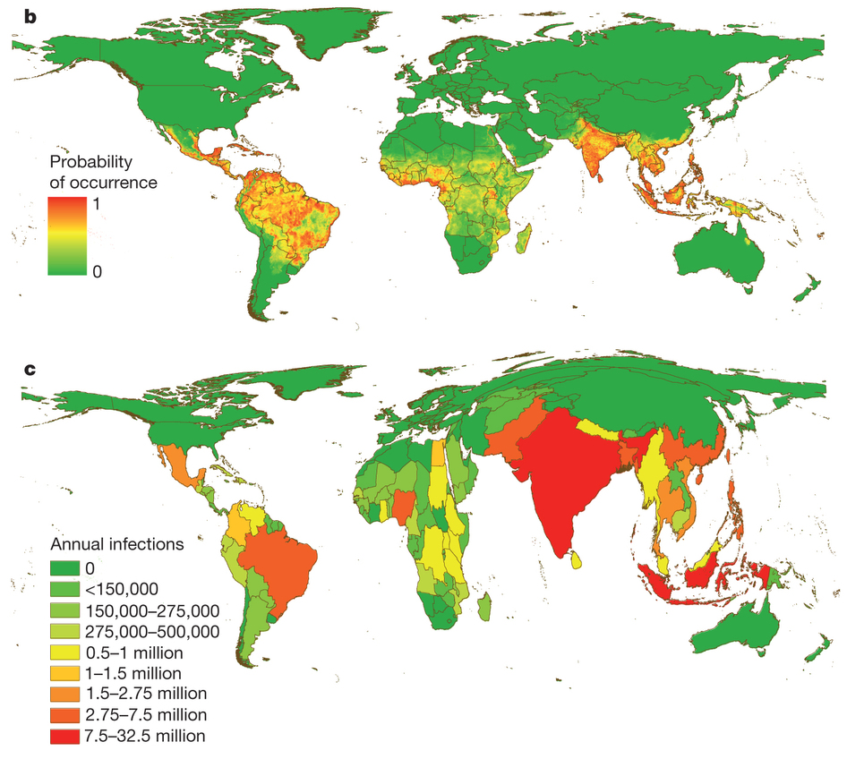
Bhatt et al. 2013 Nature

Slide 7
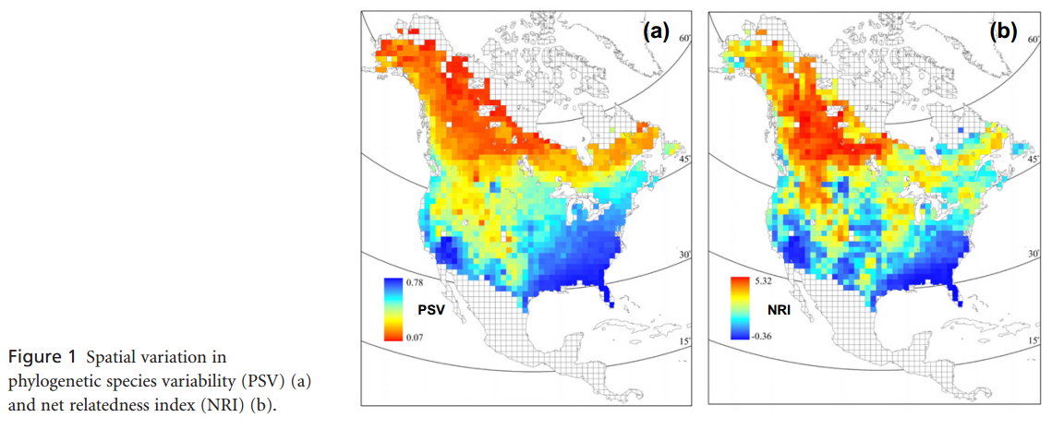
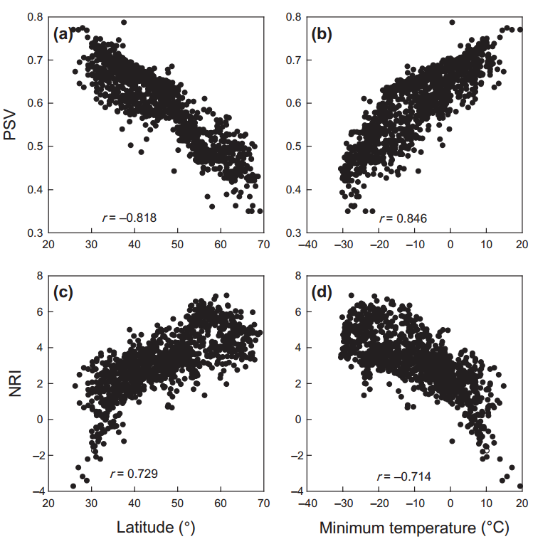
Qian et al. 2013 GEB

Slide 8
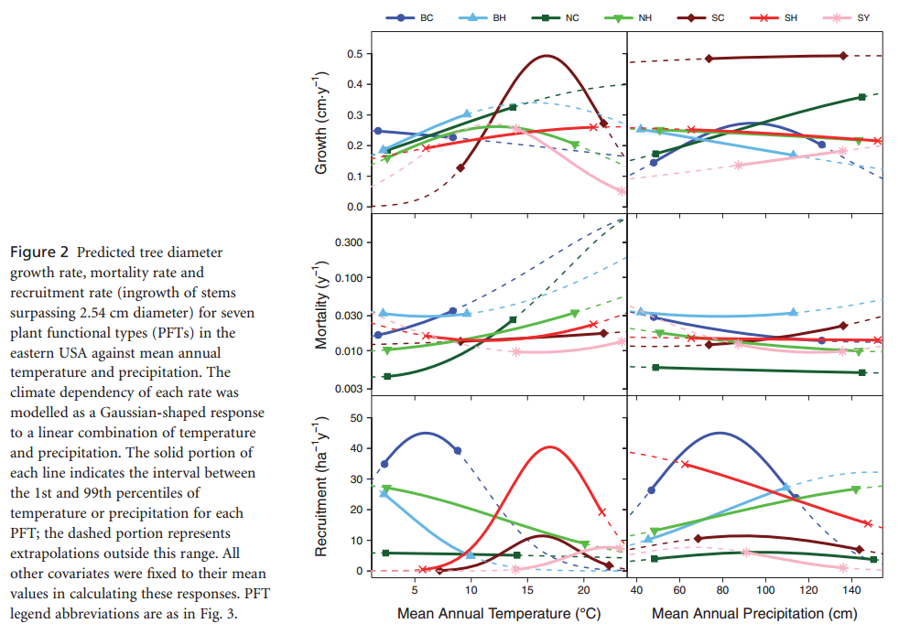
Vanderwell et al. 2013 GEB

Slide 9
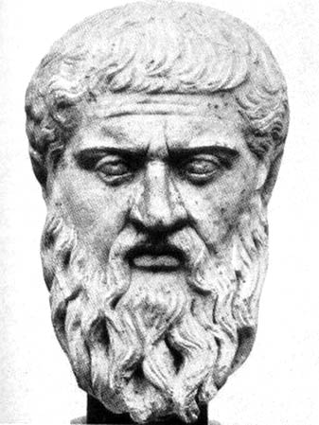
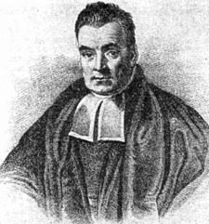
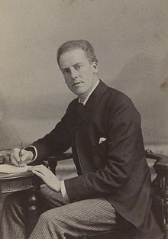
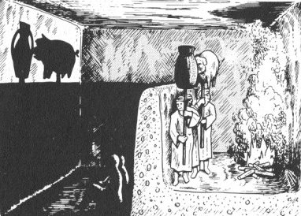
Plato
Karl Pearson
The model
The data
The world out there

Slide 10
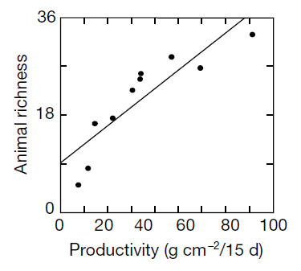
Chase & Leibold 2002 Nature
P(D|H) : the LIKELIHOOD
Probability (frequency) of the data, given the hypothesis.
Is only useful for indirect statements about the hypotheses.
Easy to calculate.
P(H|D)
Strength of our belief in the hypothesis, given the data.
Can be used for direct statements about the hypotheses.
Difficult to calculate.

Slide 11
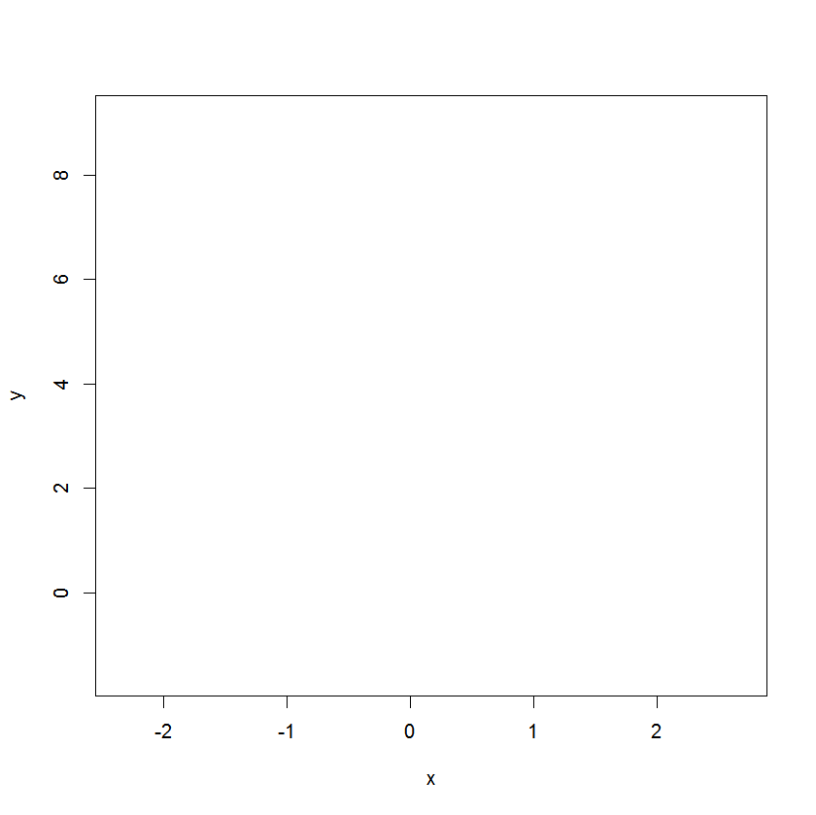
Normal linear regression (GLM family “Gaussian”)
Response, dependent variable, explained variable
Predictor, independent variable, explanatory variable

Slide 12
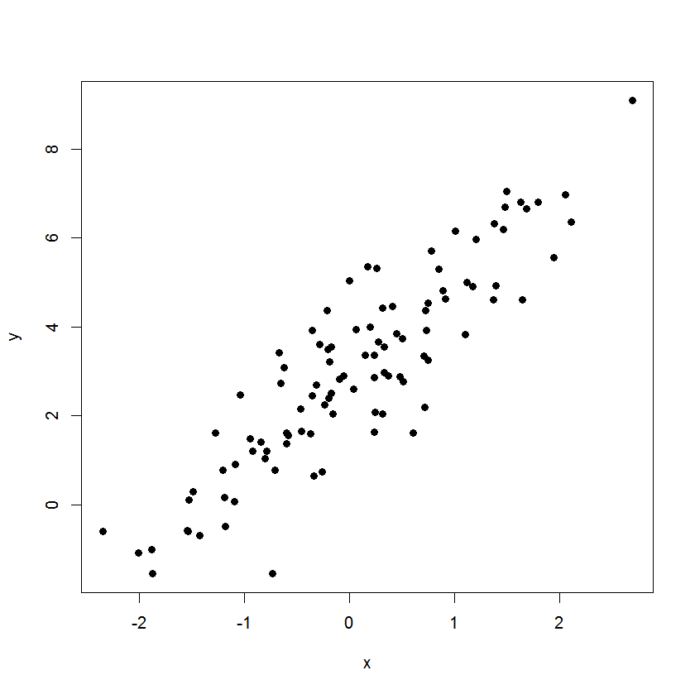
Normal linear regression (GLM family “Gaussian”)
Data
Response, dependent variable, explained variable
Predictor, independent variable, explanatory variable

Slide 13
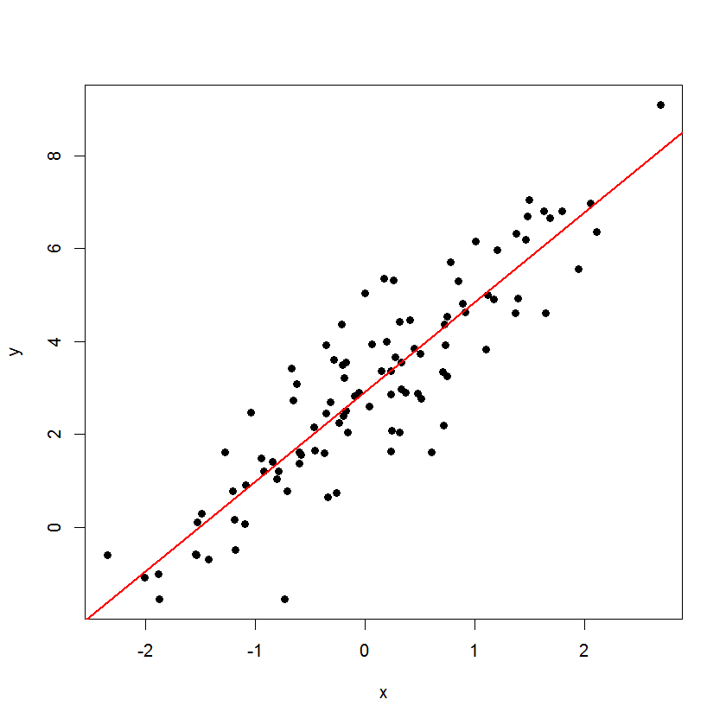
Normal linear regression (GLM family “Gaussian”)
Model

Slide 14
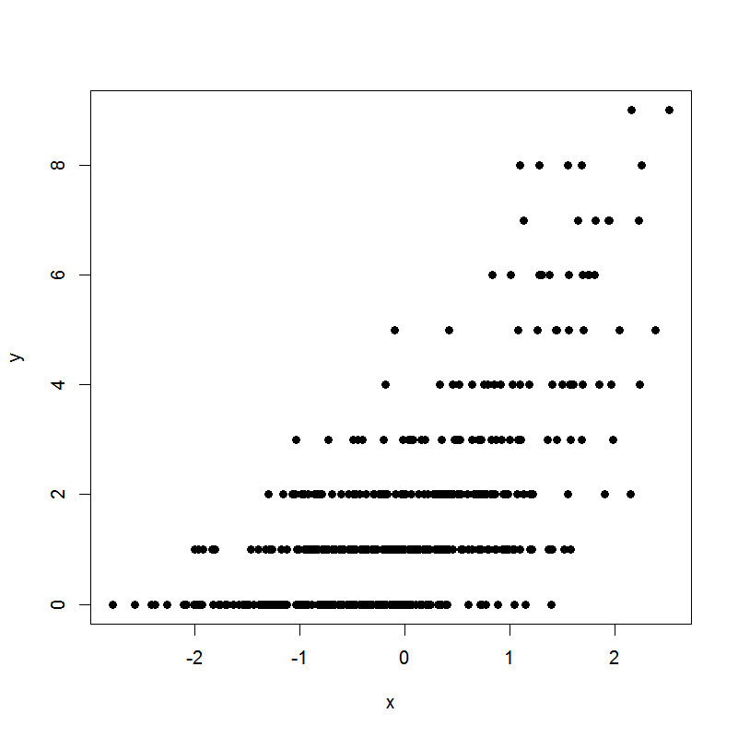
Poisson log-linear regression (GLM family “Poisson”)

Slide 15
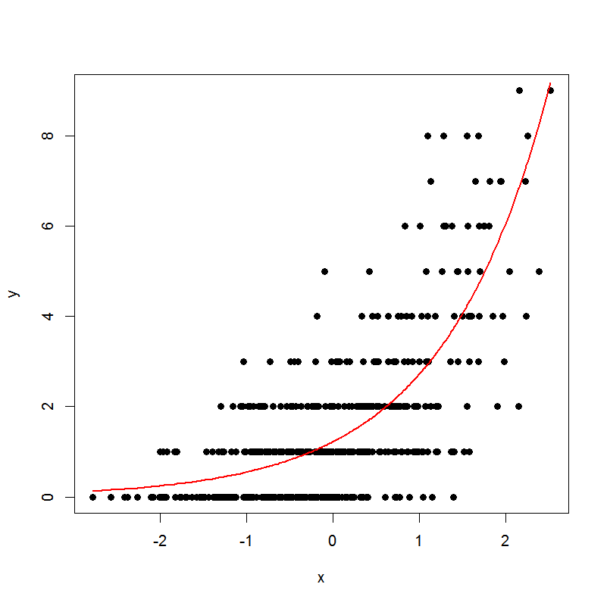
Poisson log-linear regression (GLM family “Poisson”)
Model

Slide 16
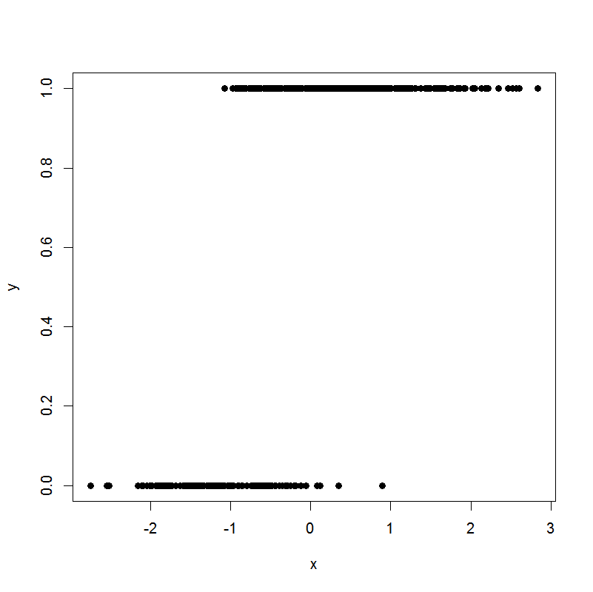
Binomial (logistic) regression (GLM family “binomial”)

Slide 17
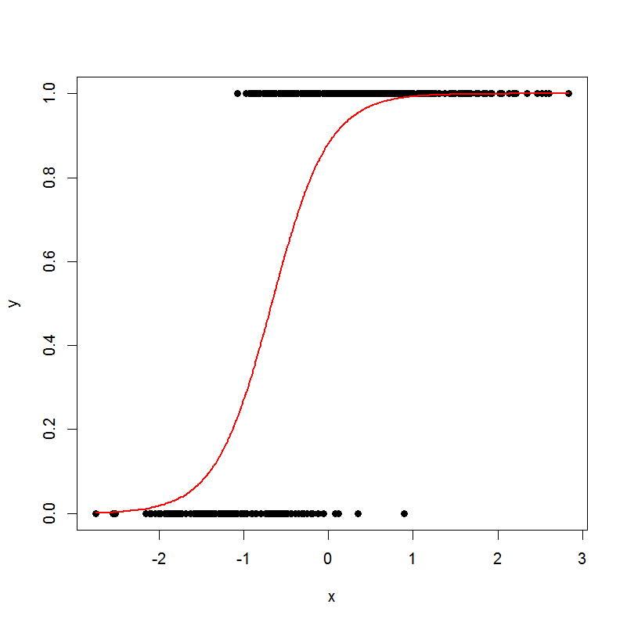
Binomial (logistic) regression (GLM family “binomial”)
Model

